Slide 1
recreate shapes with same colors.py
The goal of this python module is to get all shapes with the same color.
How does it get all shapes of the same color?
It first gets average RGB value of every shape. Then it searches every shape to determine shapes that have same color .
Once getting all the shapes with the same color, they are all put together. Next slides show you the results of executing this module.

Slide 2
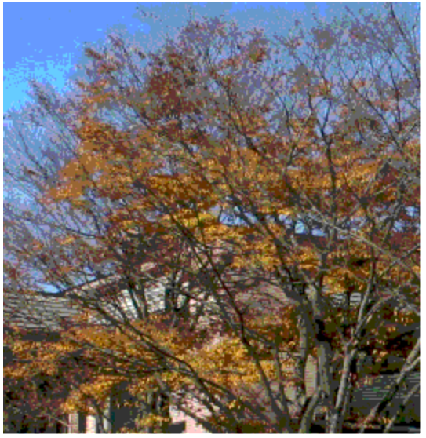
Original image

Slide 3


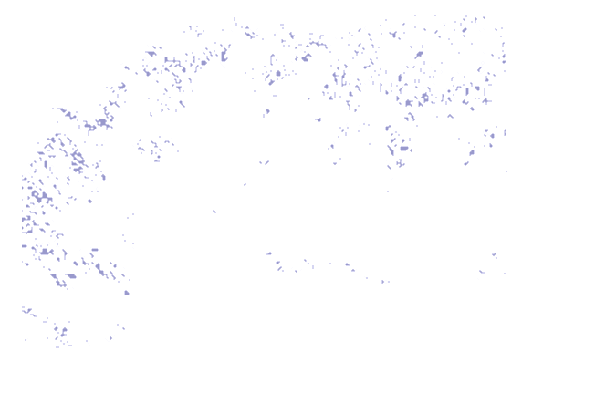
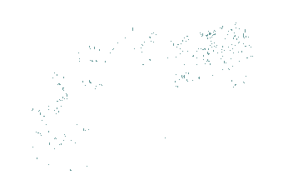
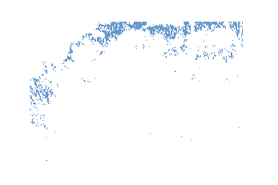
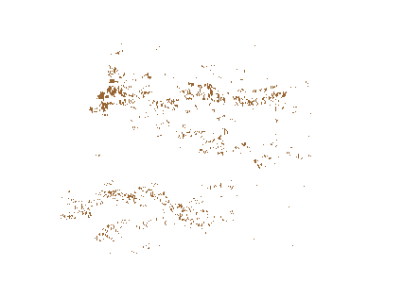
results

Slide 4
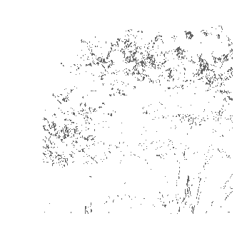
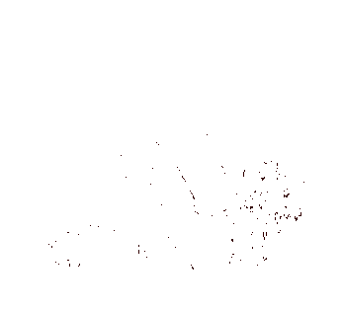
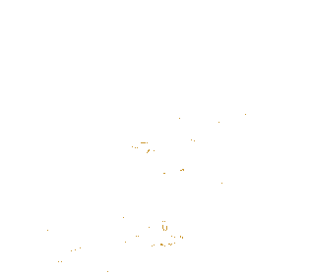
As you can see, all shapes that have the same color are put together.

